Slide 1
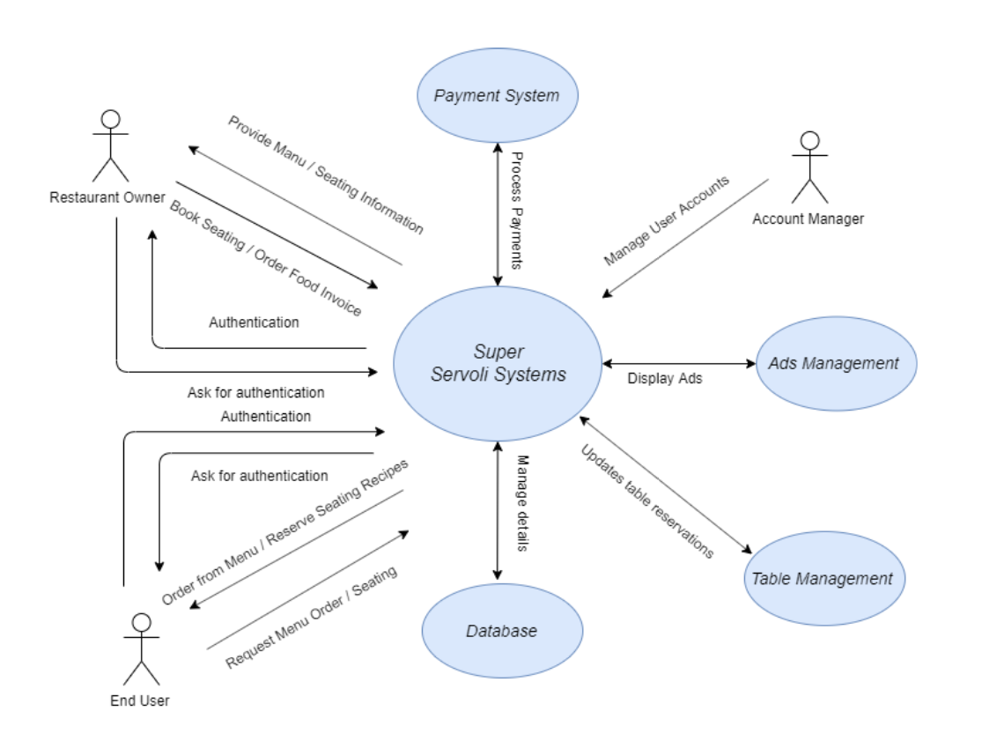
Super Servoli System Context Diagram

Slide 2
System Interface Table
Description | Source | Target | Frequency | Validation
Process Payments | Payment System | Super Servoli System | Real-time | Orders processed will have final price match the sum of all selected menu items.
Displays Ads | Ads Management | Super Servoli System | Real-time | Ads will rotate and display while users are browsing the application
Houses application data | Database | Super Servoli System | Real-time | Database validation to check if the the data entered in the database is correct.
Maintains reserved tables | Table Management | Super Servoli System | Real-time | Checks to see if any updates to the restaurant table has been made before booking the reservation

